Slide 1

“It’s the refs fault!”

Slide 2


The scraping process

Slide 3
Why should we care?

Slide 4
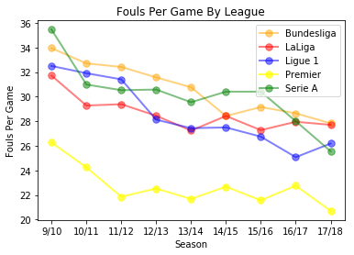

Slide 5
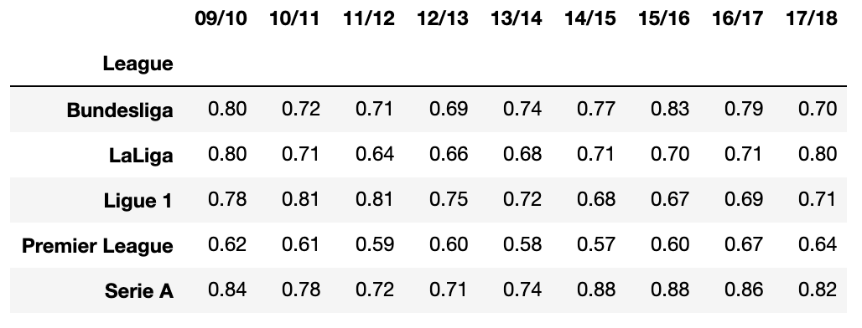
Average foul per tackle

Slide 6
To make sense of all the numbers
The average percentage of tackles made that will be considered a foul:
Bundesliga: 75%
LaLiga: 71.2%
Ligue 1: 73.6%
Premier League: 60.9%
Serie A: 80.3%

Slide 7
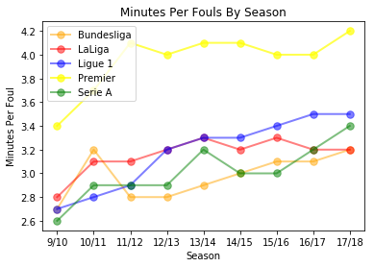
To add more context
Average Time Without a Foul Across All Leagues and Seasons = 3.2 min
Average Time Without a Foul Across All Leagues, During 17/18 Season = 3.47 min

Slide 8
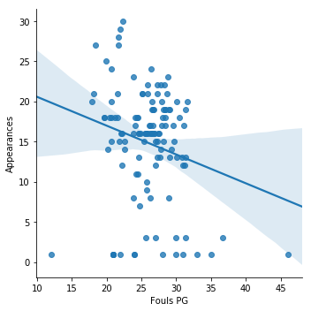
correlation between fouls per game and appearances during 2017/18 Season

Slide 9
What does this show?
Referees are quick to call a foul, meaning less playing time and opportunities to score.
Referees are humans and implement the rules based on their interpretation.
Being on the good side of the referee could be in our favor, meaning more playing time between fouls
Parts of the soccer training model could change.
If a foul occurs every 5-6 minutes with 10-40 seconds of rest, then training could mimic that.

Slide 10
Next steps
Identify which referee will be officiating the game my team will be participating in.
Knowing the ref means I’ll be aware of what to potentially expect from the game.
Adjust training to incorporate 5-6 minutes of high intense training with 10-40 seconds of rest.

Slide 11
If I had more time
Name | Appearances | Home Win % | Away Win % | Draw %
Michael Oliver | 30 | 30 | 36.7 | 33.3
Jonathan Moss | 29 | 27.6 | 37.9 | 34.5
Martin Atkinson | 28 | 35.7 | 39.3 | 25
Anthony Taylor | 27 | 44.4 | 22.2 | 33.3
Andre Marriner | 27 | 51.9 | 37 | 11.1
Mike Dean | 25 | 44 | 28 | 28
Craig Pawson | 24 | 62.5 | 20.8 | 16.7
Kevin Friend | 21 | 66.7 | 9.5 | 23.8
Neil Swarbrick | 20 | 55 | 30 | 15
Graham Scott | 20 | 55 | 30 | 15

